Slide 1
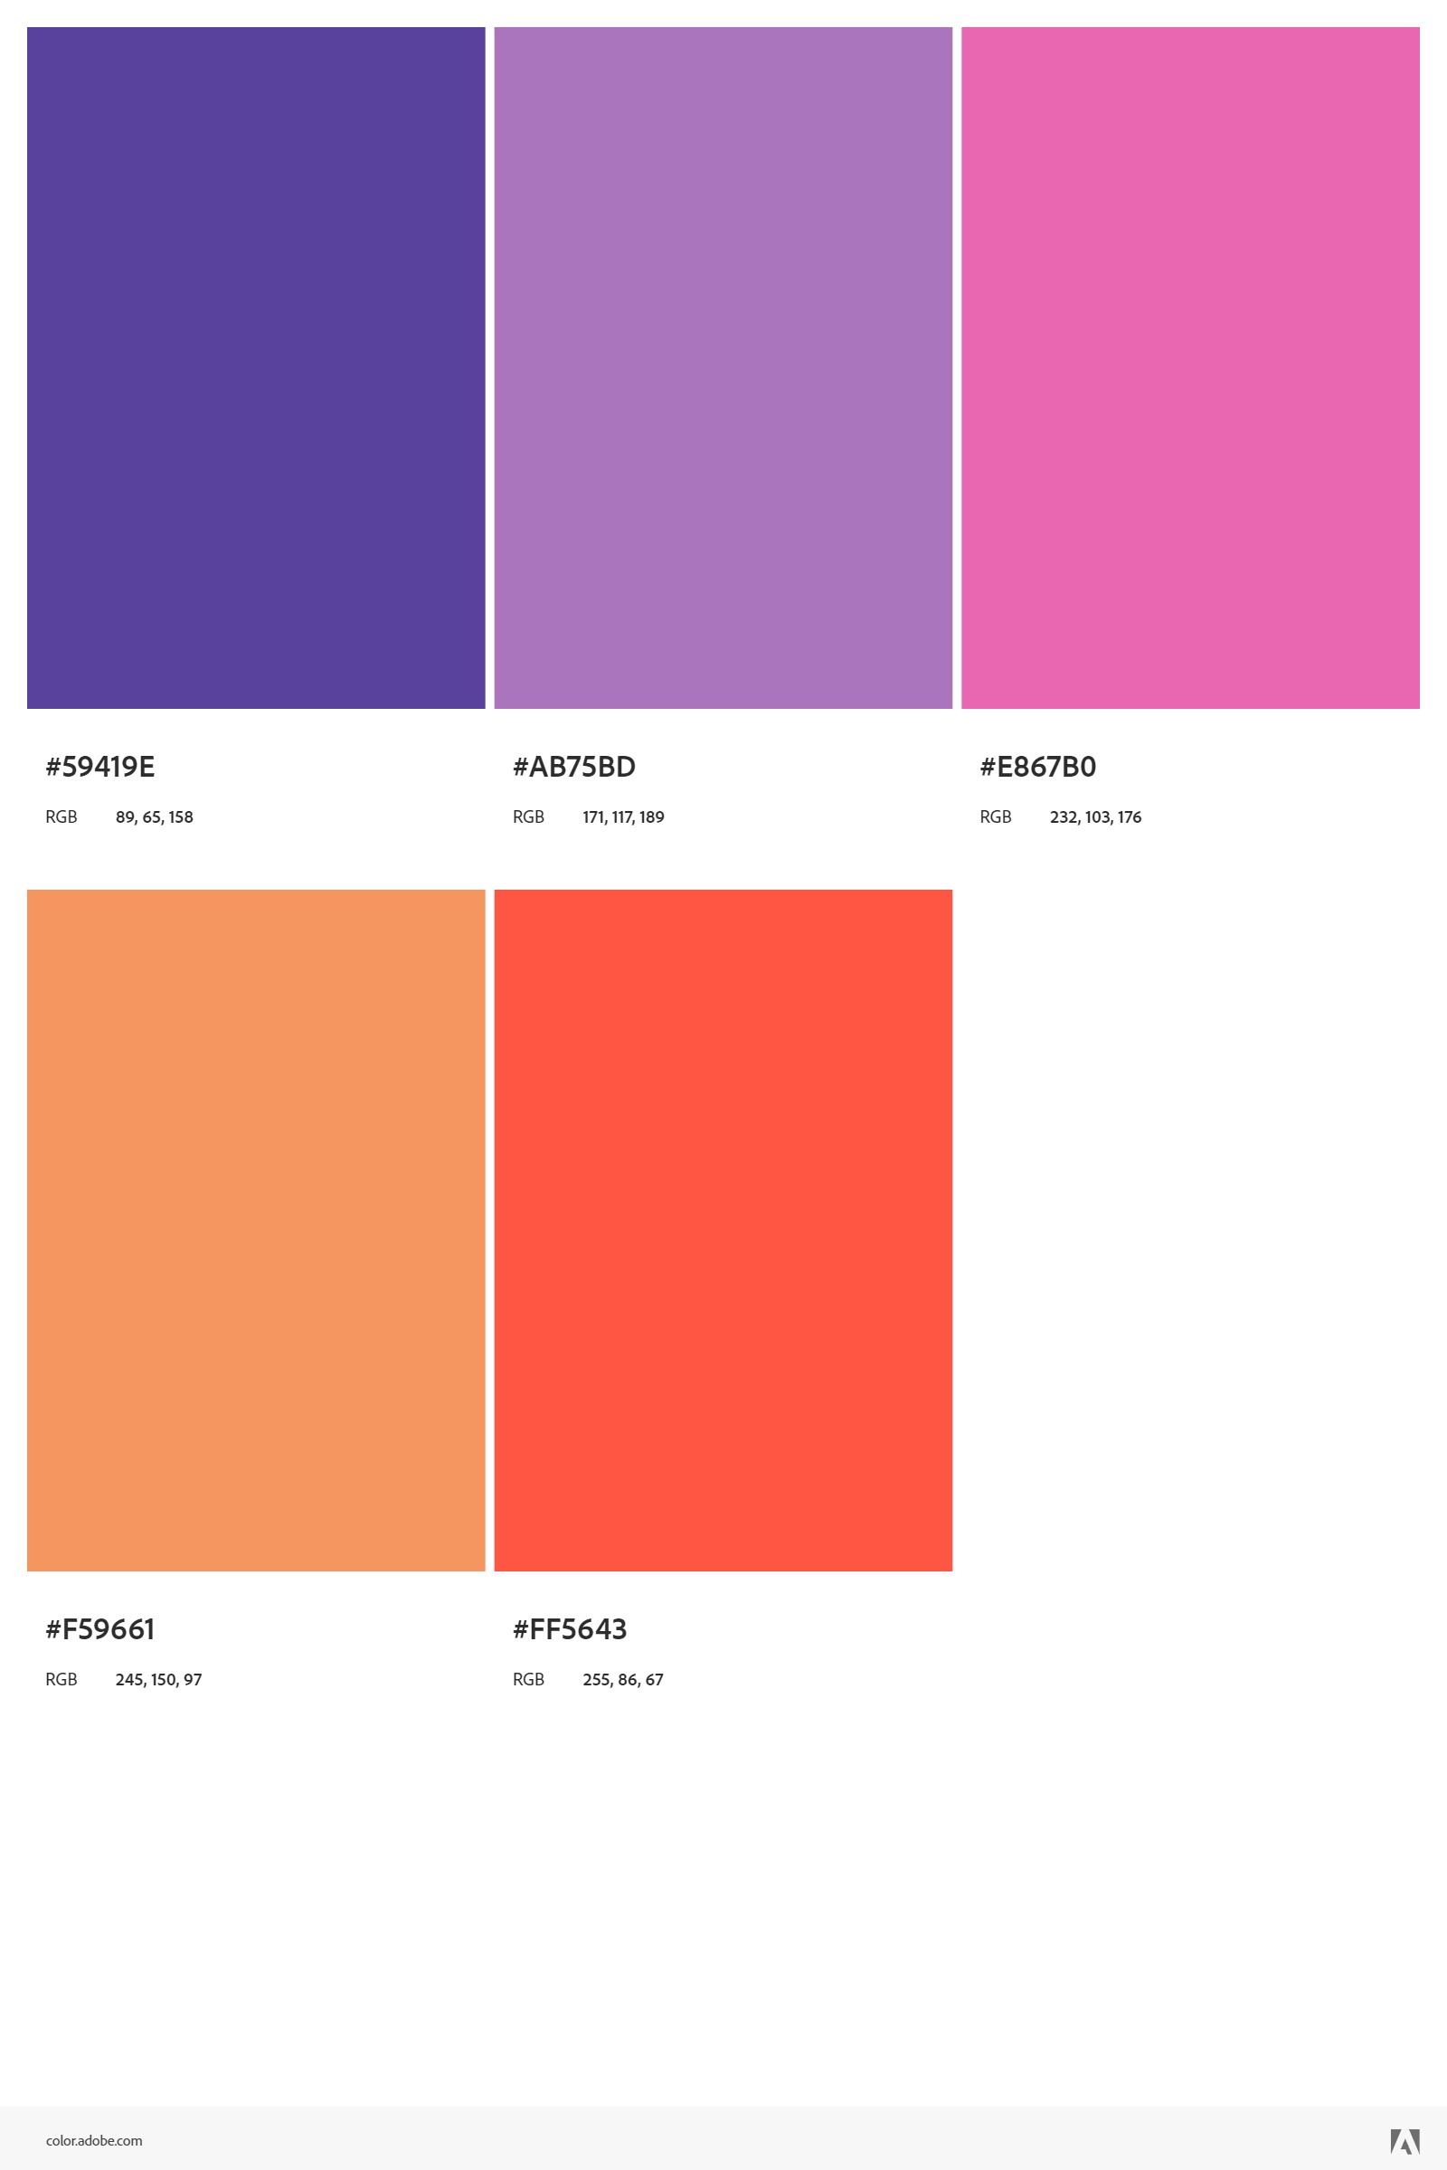








Image Histogram Analyzer
Ahmed Farag

Slide 2

INTRO
DUCTION

Slide 3
INTRO
DUCTION

Slide 4
What is an Image Histogram?
How Histogram Equalization Works
Benefits of Histogram Equalization

Slide 5

PROBLEM
DEFINITION

Slide 6
PROBLEM
DEFINITION

Slide 7
Bad Lighting Conditions
Environmental Conditions
Redistribution of Intensities

Slide 8

FLOW
CHART

Slide 9
FLOW
CHART

Slide 10
https://www.figma.com/board/vPM4fOjqBod4HcWm2gBquY/Digital-flow-chart?node-id=0-1&t=0qhhVdoEwDV5ybFN-1

Slide 11

RESULTS

Slide 12
RESULTS

Slide 13
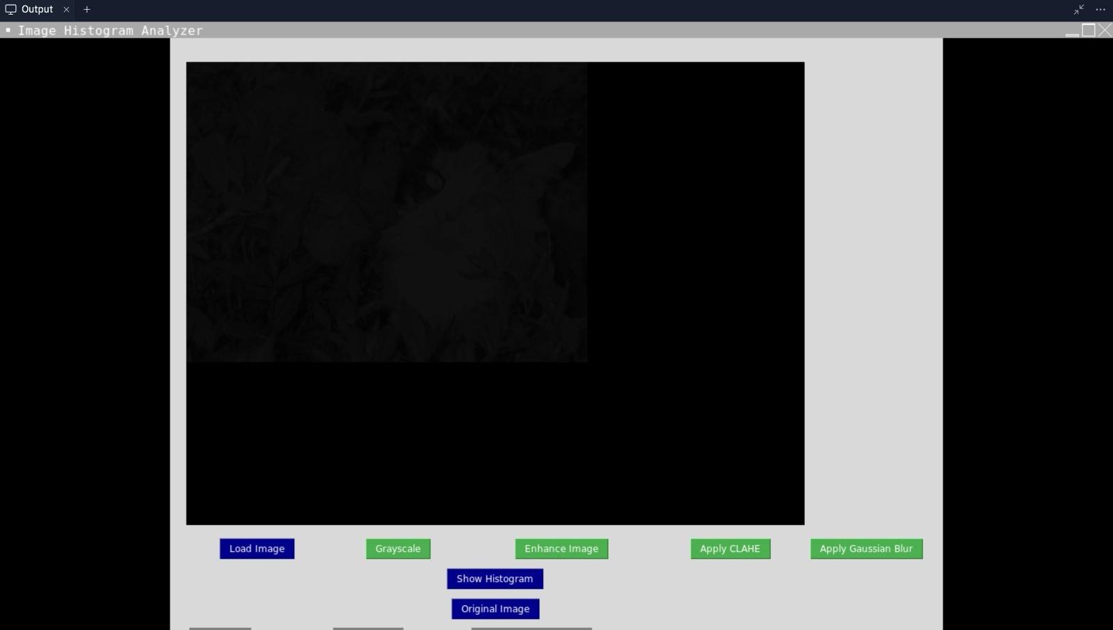
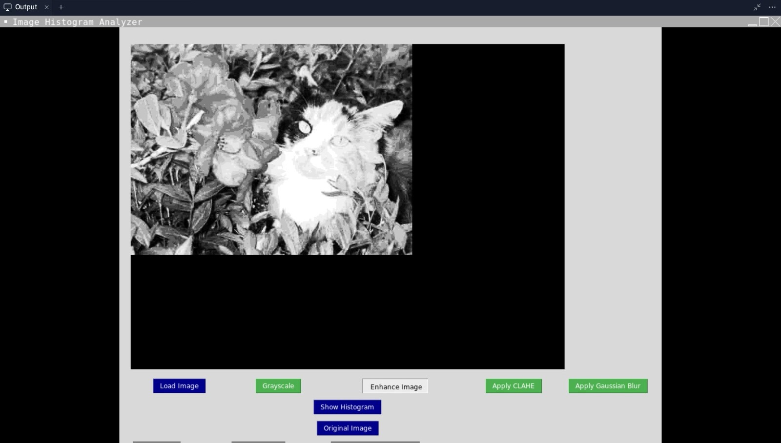
Before
After

Slide 14
LINK
https://github.com/faraggggg/Digital-image-project

